Slide 1





School World Order
The great reset & the fourth industrial revolution

Slide 2
The New world order
Round Table NGOs
Global Governance Institutions
Multinational Corporations
National Governments
Technocracy
Stakeholder Capitalism
Sustainable Development
Social Credit
Transhumanism

Slide 3








Roundtable oligarchy

Slide 4
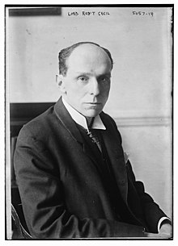
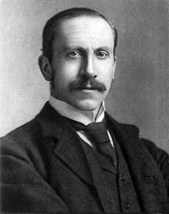
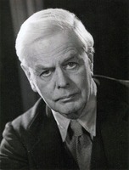

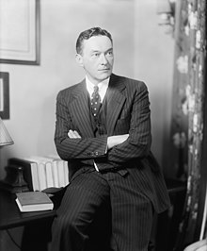
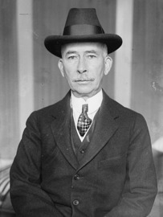
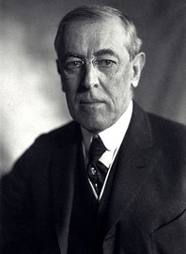
The roundtable origins of global government

Slide 5








Global governance branches

Slide 6

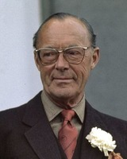
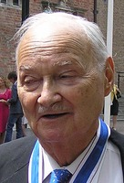


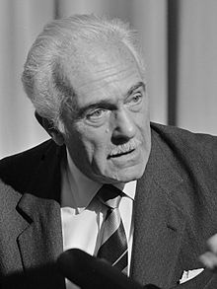
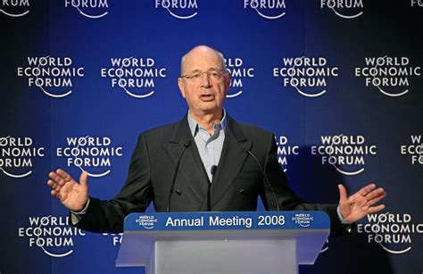
UN Agenda 2030
SDG 4: Quality Education
4.4: Polytechnical workforce training
4.7: Global citizenship
SDG 17: Partnerships for the Goals
17.16: Multi-stakeholder partnerships
17.6: Increase global access to technology
  4.b: Globally expand IT & STEM education
17.8: Enhance use of IT & other technologies
17.17: Public-private partnerships

Slide 7















UNESCO Global education coalition

Slide 8
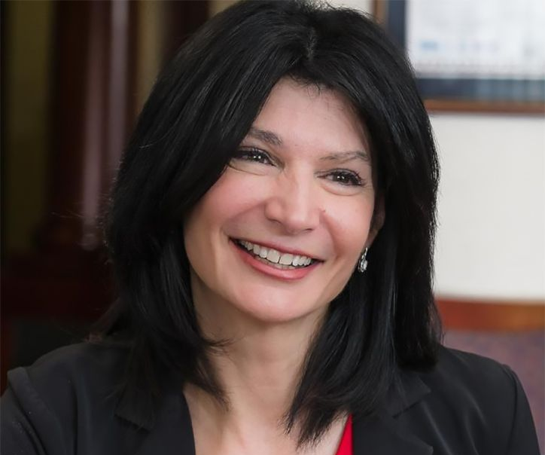
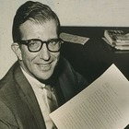


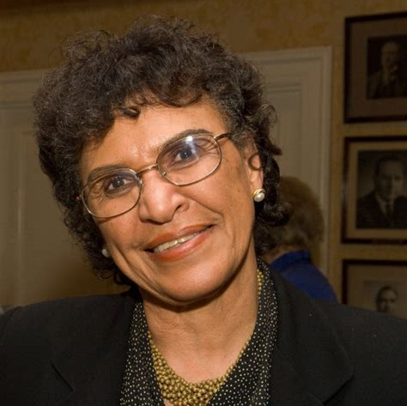


Education international, unesco, & the wef

Slide 9
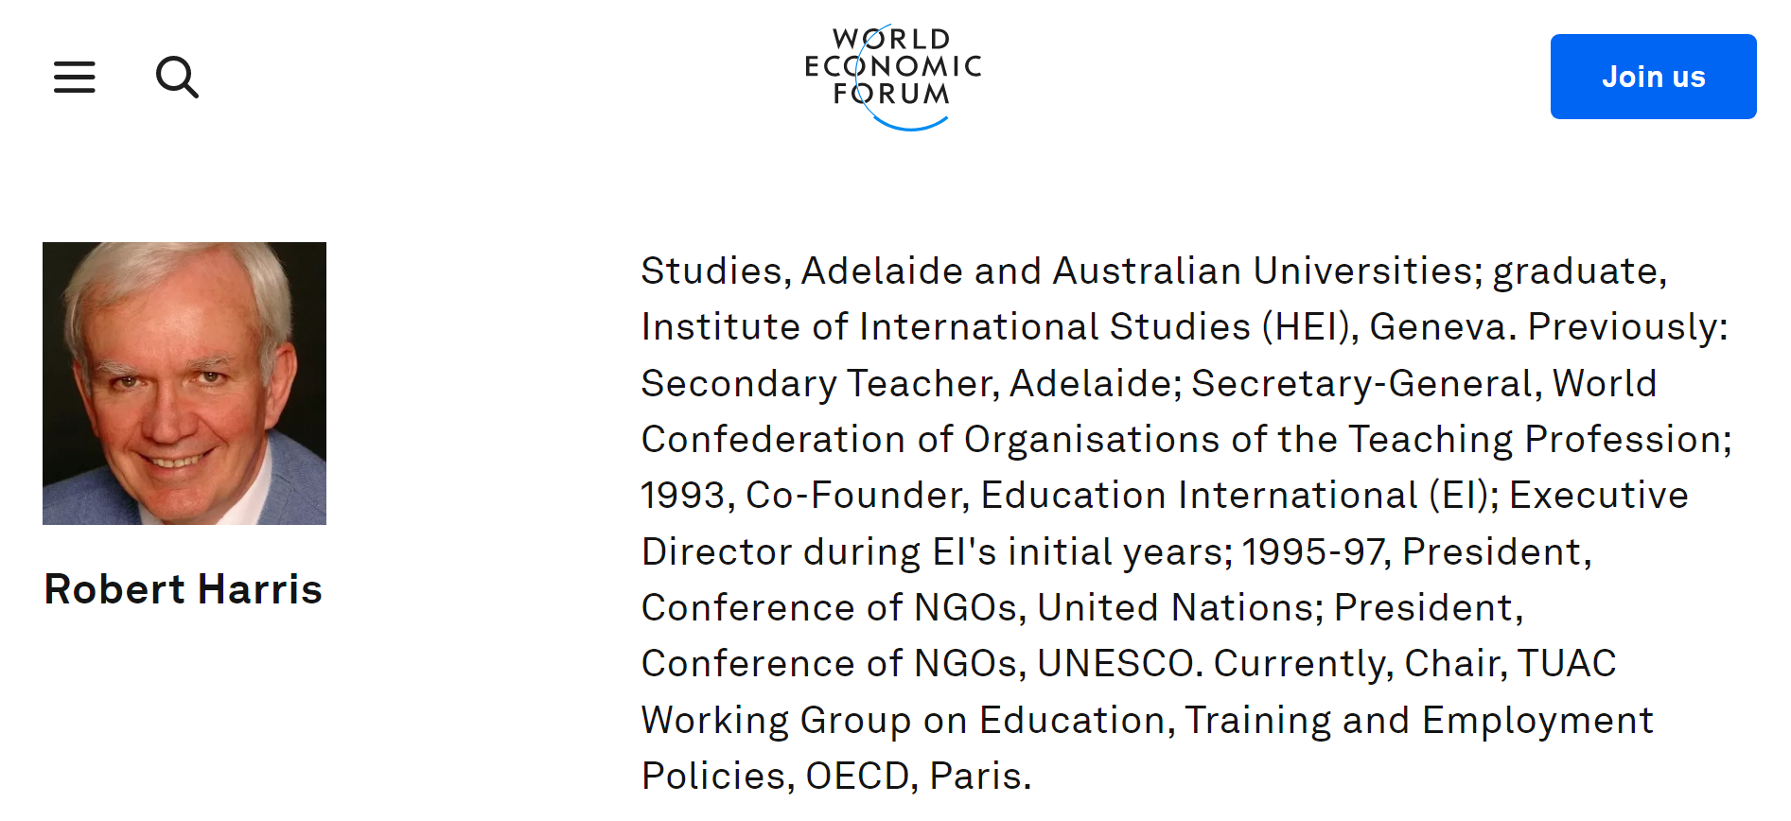
Ei founding member: Robert harris

Slide 10


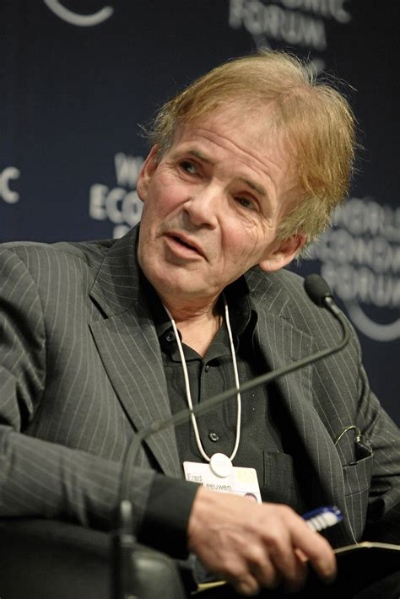









Ei founding general secretary: fred van leeuwen

Slide 11
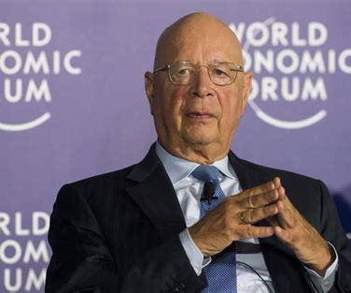

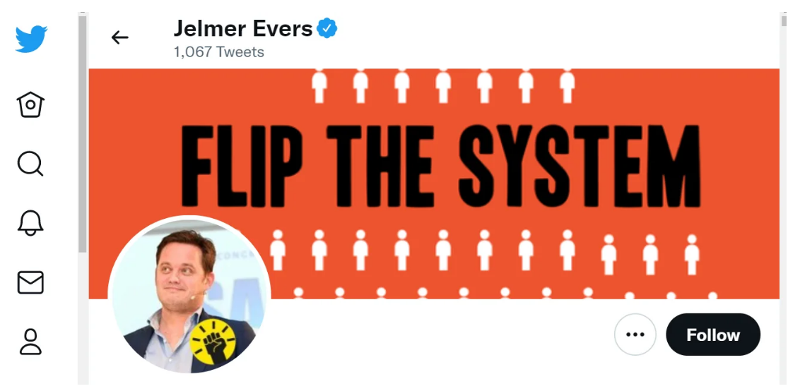

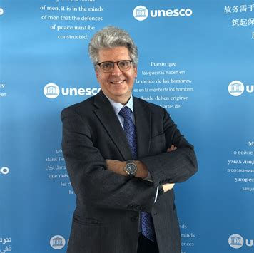
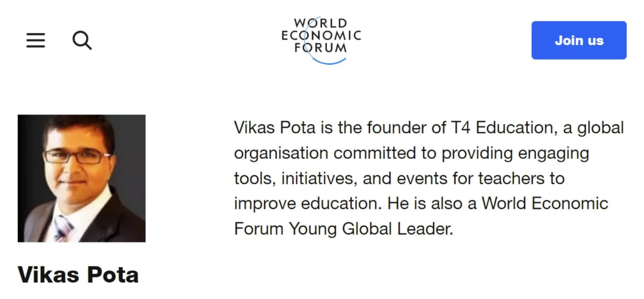
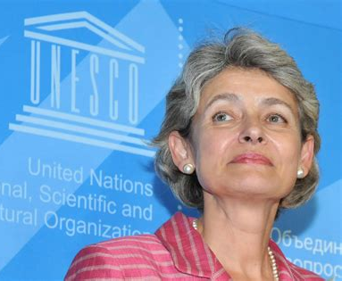
EI Member jelmer evers: teaching in the 4ir

Slide 12
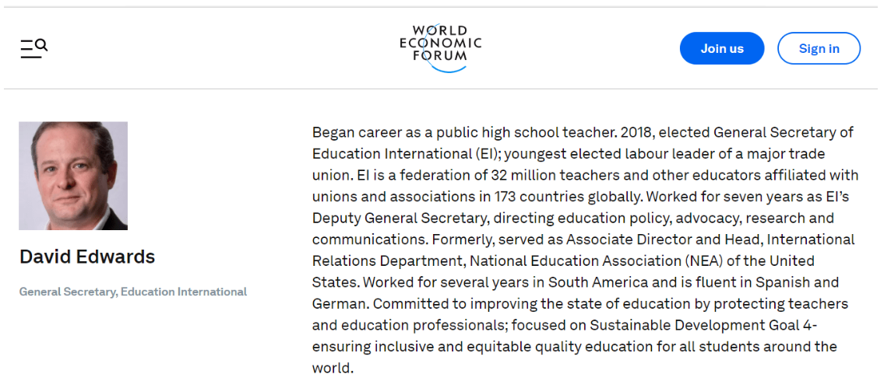


EI General secretary: David edwards

Slide 13






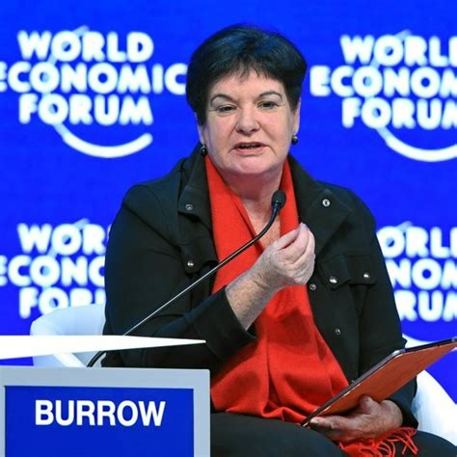
EI vice president: sharan burrow

Slide 14
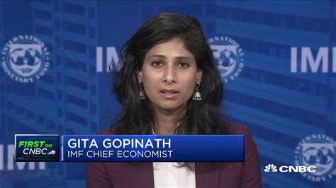
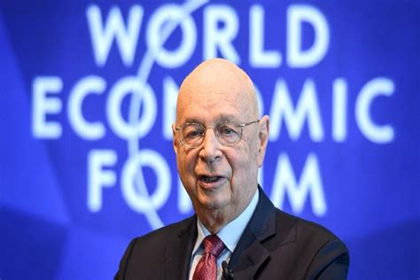

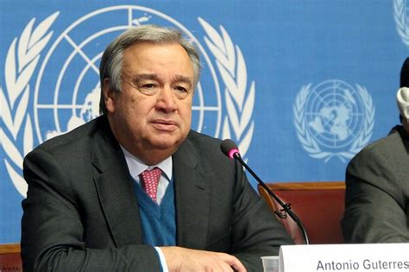
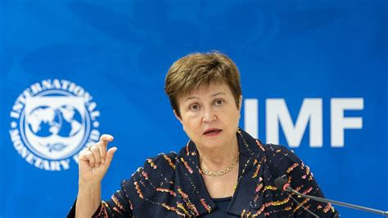

Sharan burrow & the great reset

Slide 15
4IR Education technologies
Adaptive-Learning Courseware
Socio-Emotional (SEL) Biofeedback Wearables
Brain-Computer Interfaces (BCIs)
Implantables
Wearables
Mobile Computers

Slide 16
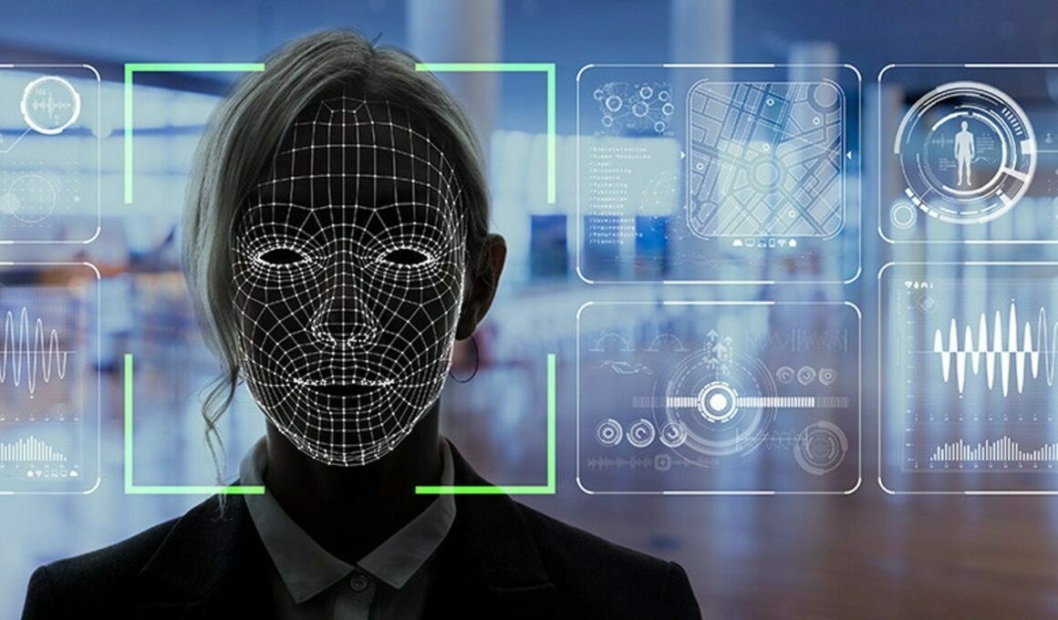
Ed-tech Data-mining
Artificial Intelligence (AI) Programming
Social Credit Scoring
Transhuman Engineering

Slide 17



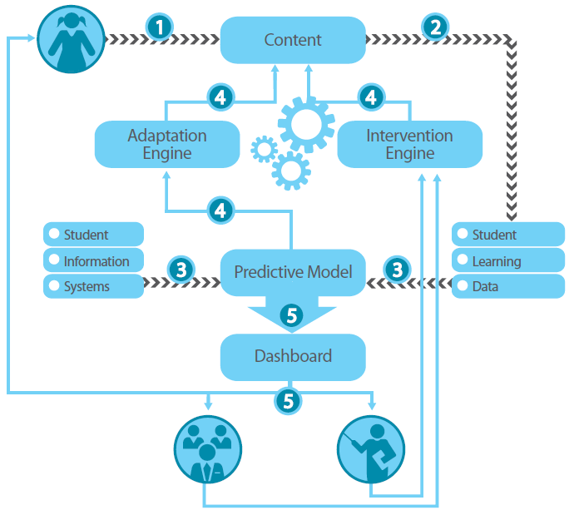



Adaptive-learning courseware

Slide 18
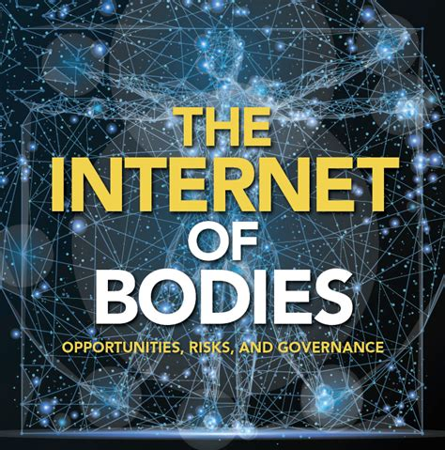
Socio-emotional (seL) biofeedback wearables
Electroencephalogram (EEG) Headgear
Electrocardiogram (ECG) Monitors
Galvanic Skin Response (GSR) Bracelets
Facial Recognition Scanners

Slide 19


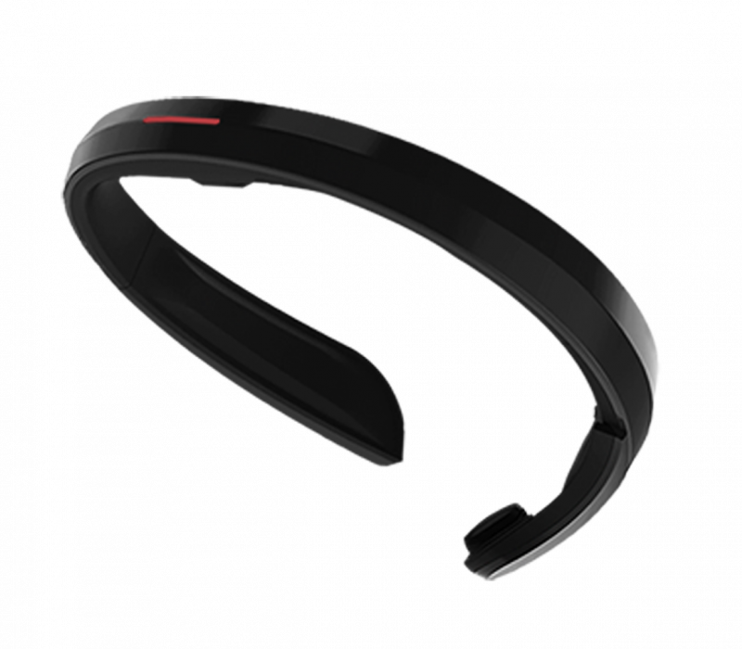

EEG headgear

Slide 20

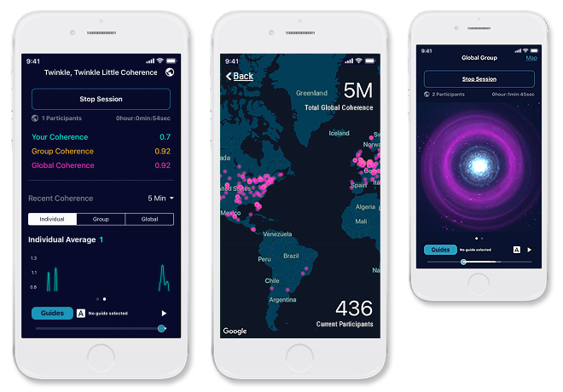

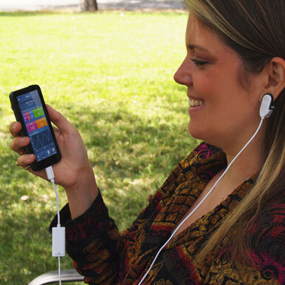
ECG monitors

Slide 21
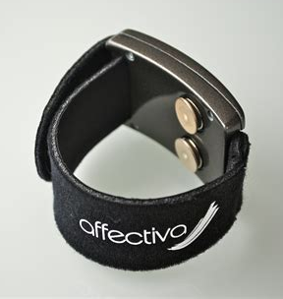
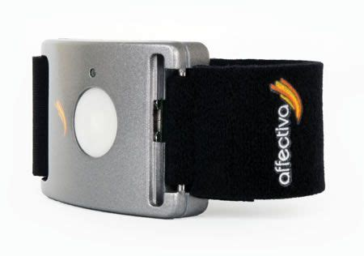
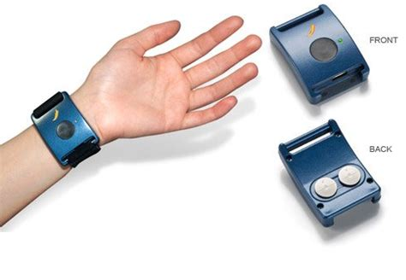


Gsr bracelets

Slide 22
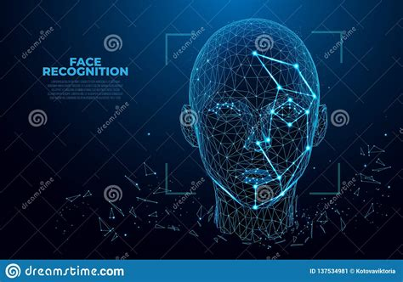
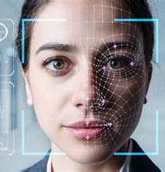
Facial-recognition scanners

Slide 23
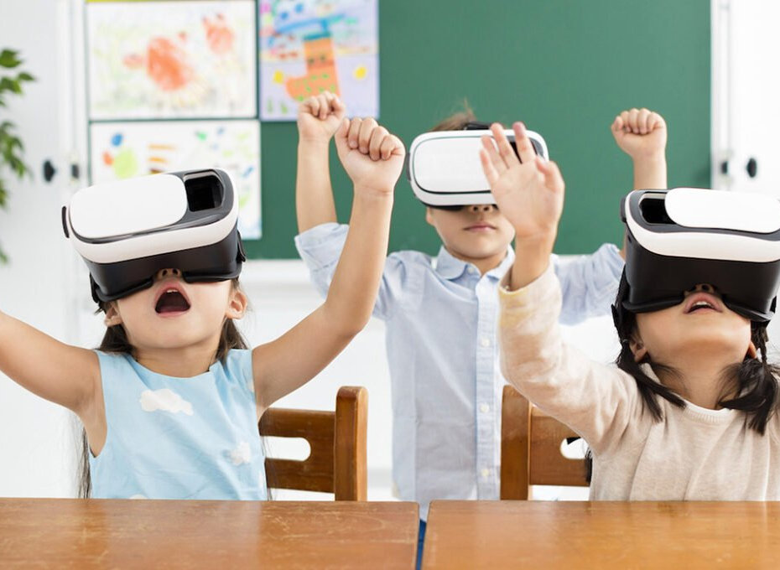
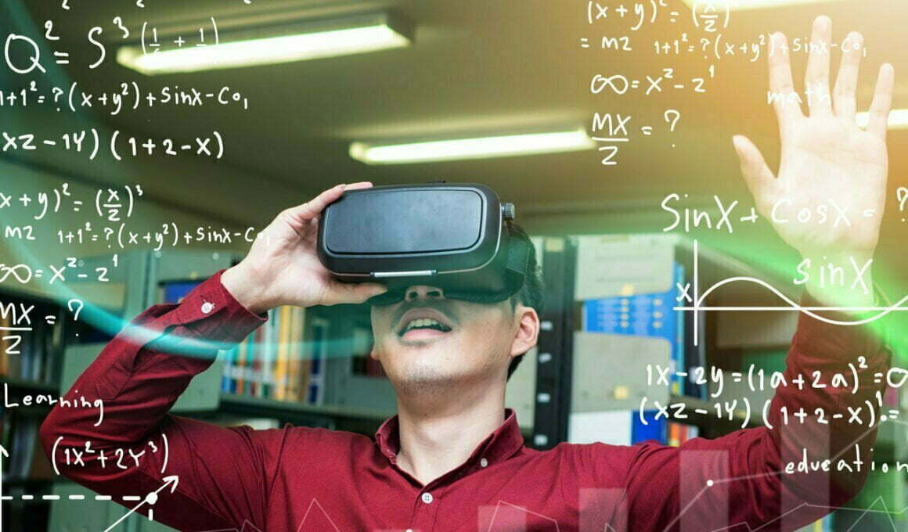
Virtual reality (VR) & augmented reality (ar) gamification

Slide 24

Social credit

Slide 25
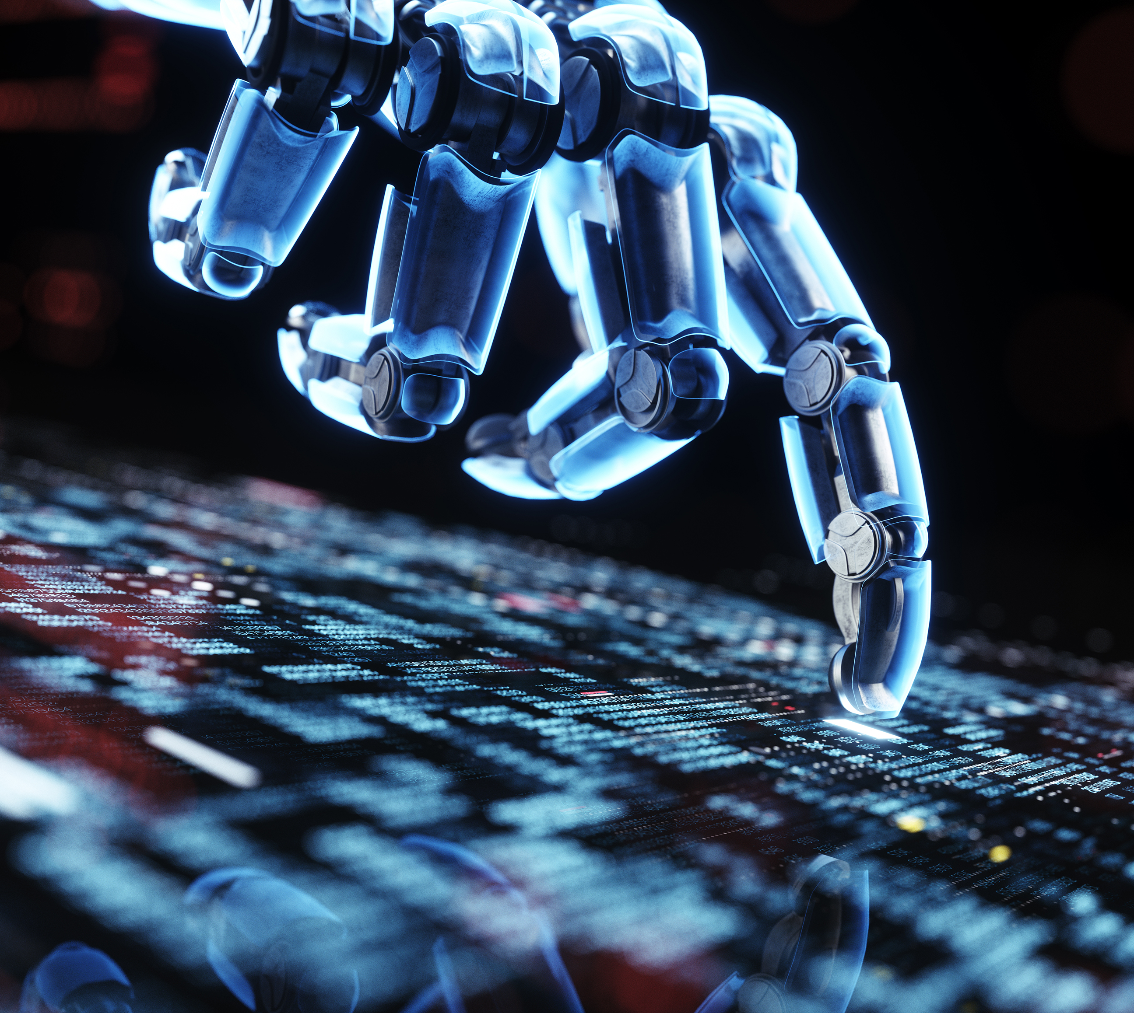
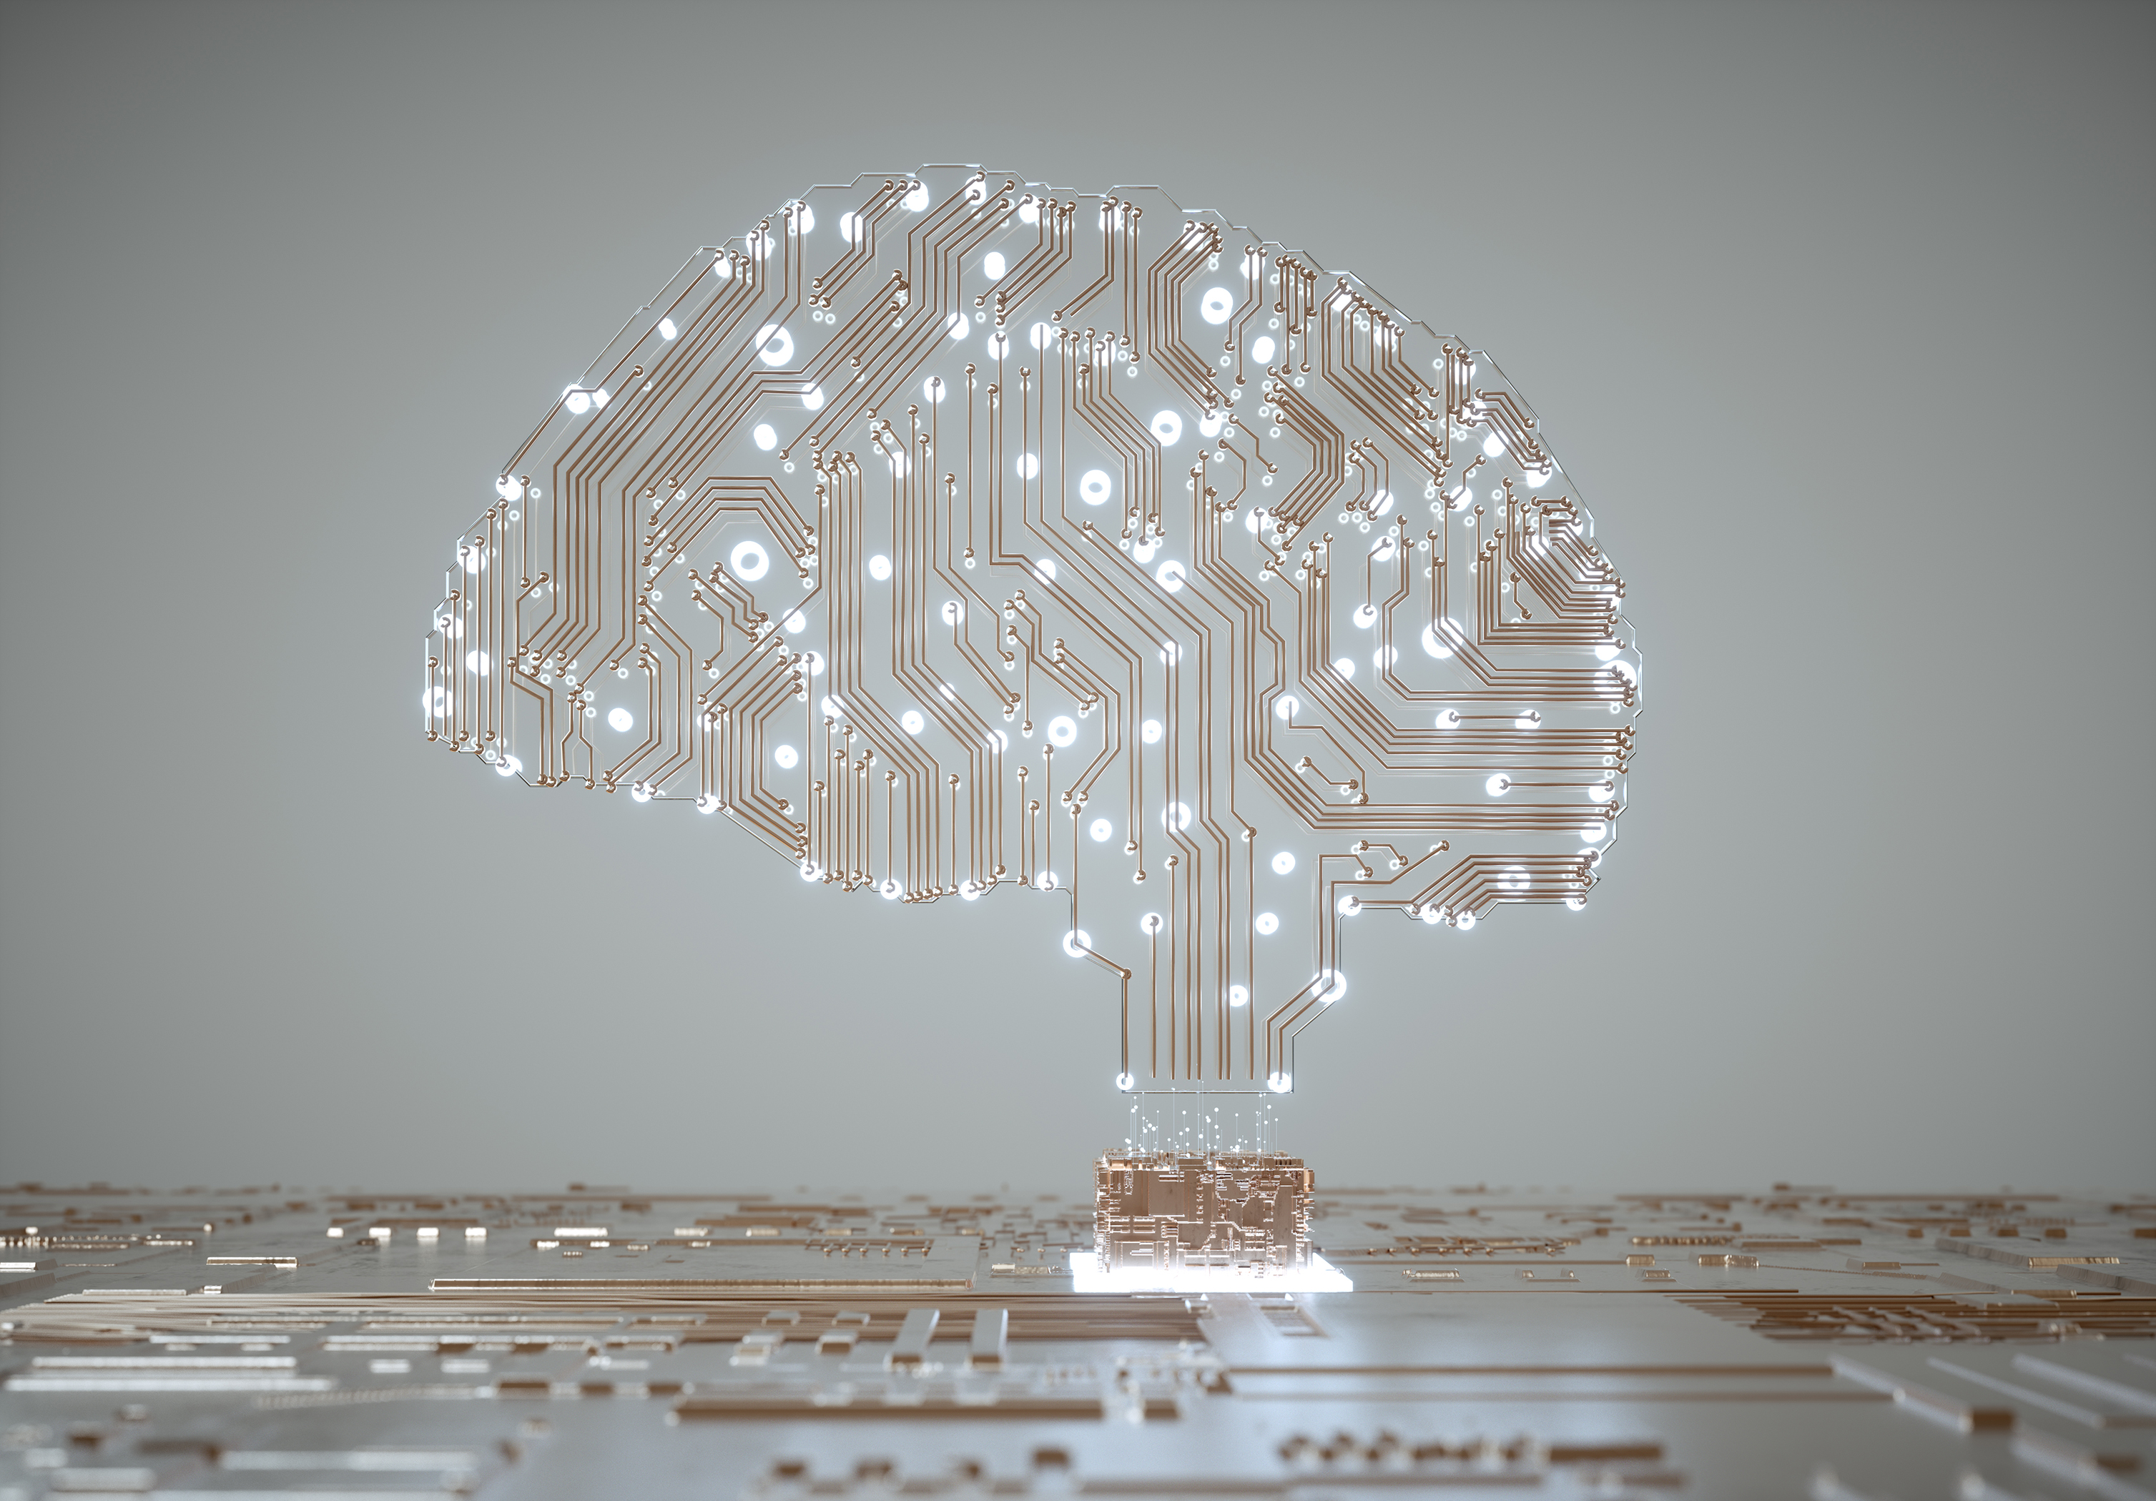
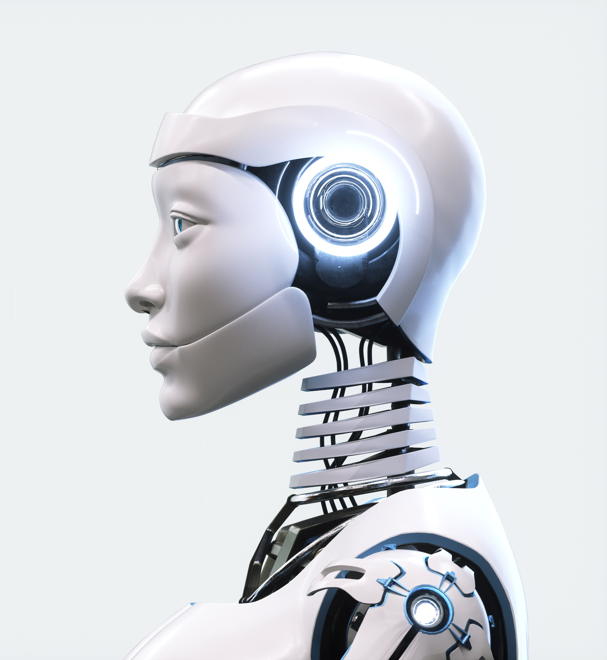
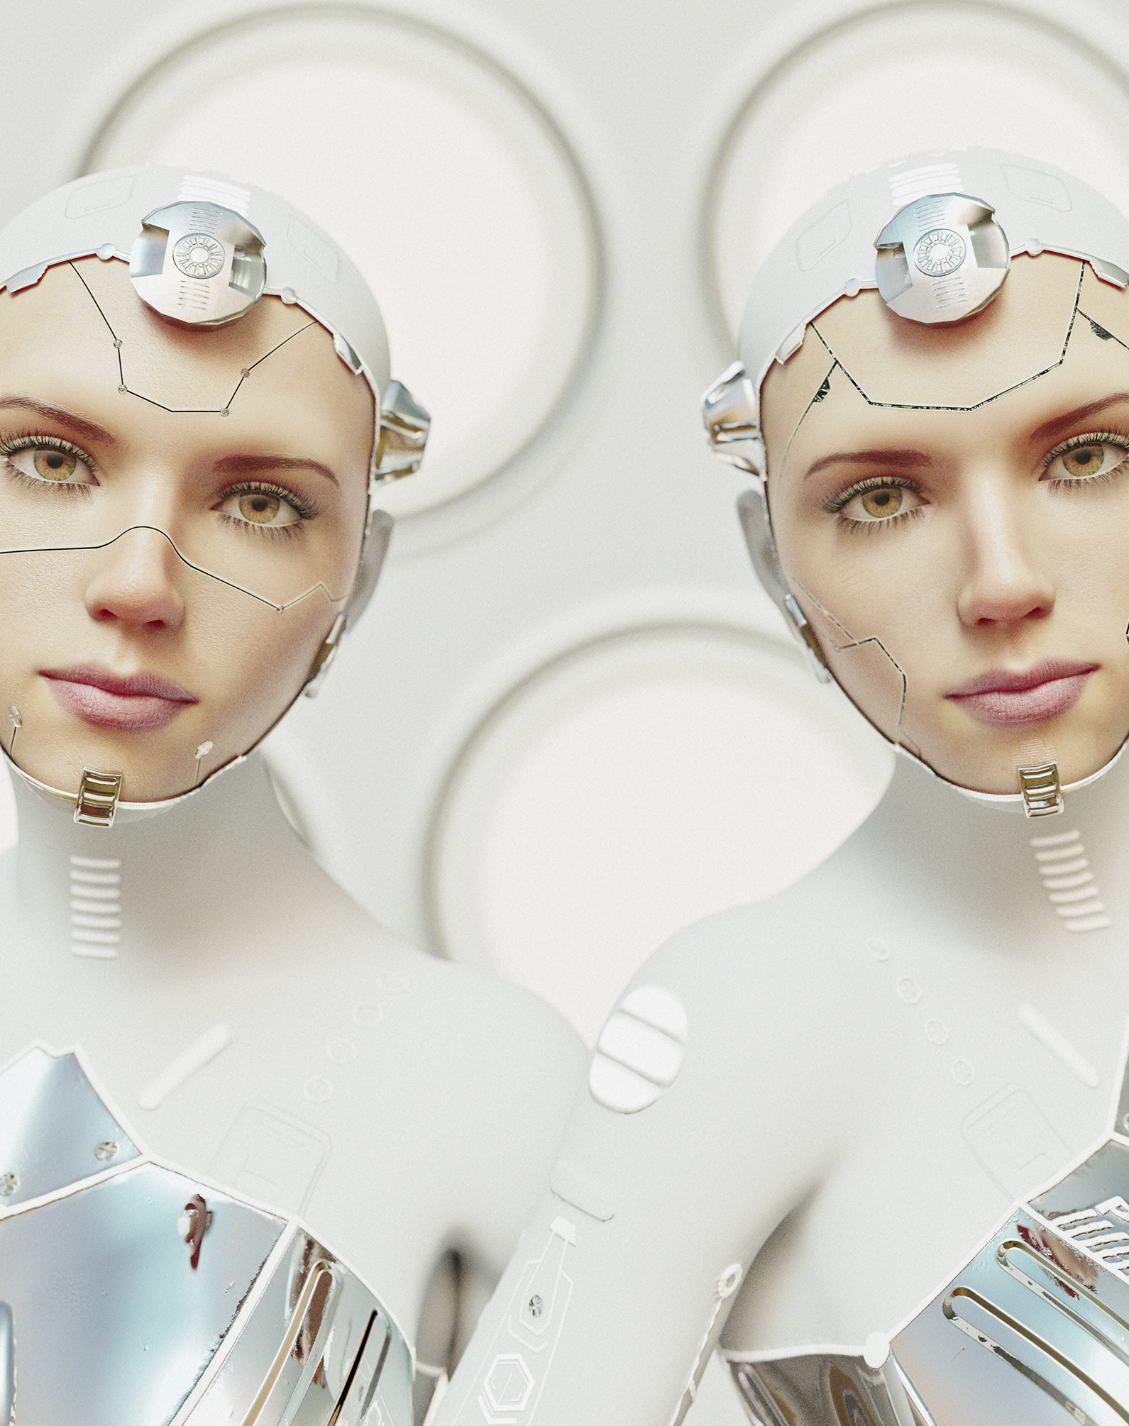
Ai data-mining

Slide 26
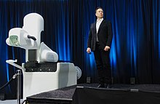
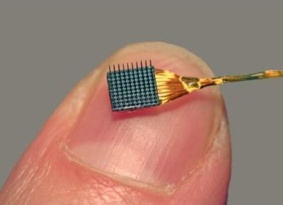
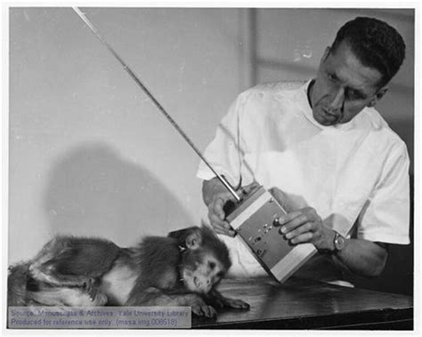
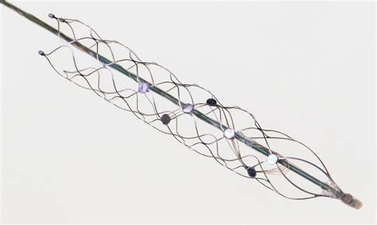

Brain-computer interfaces

Slide 27
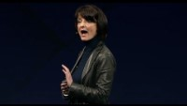
Brain-computer inter-facebook

Slide 28

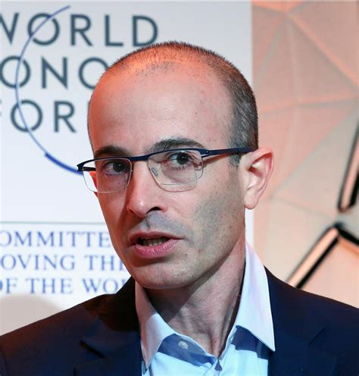
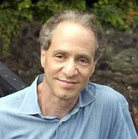
Cyborg gods or hackable animals?

Slide 29
solutions
Decouple from UNESCO
Decouple from GUFs
Decouple from the WEF
Decouple from Big Tech
Boycott Big Tech
Homeschool
Low Tech or No Tech
New Grassroots Unions
Data Privacy Rights

